Slide 1

The Radio Interferometer Measurement Equation (RIME)
O. Smirnov (Rhodes & SKA SA)

Slide 2
Basic Laws Of Interferometry
I. Thou DOST NOT understand interferometry.
II. Thou SHALT talk about interferometry.
III. When caught talking crap, thou shalt invoketh The First Law.

Slide 3
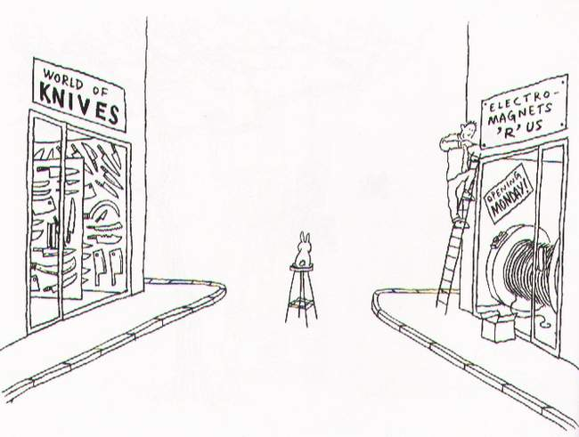
Part 1: Fundamentals

Slide 4
Plane Waves
Electromagnetic plane waves
  If monochromatic & perfectly polarized:
  EM field can be described
  by a complex 2-vector:
  No z component, and same across entire plane

Slide 5
Plane Waves II
Radiation from astrophysical sources is neither monochromatic nor perfectly polarized
Noise! Think of e waving around randomly
  But still no z component
  Still the same across the entire plane (a.k.a. transverse EM field)
Intensity & polarization can be defined in a statistical sense
OK, so how do we make an interferometer?

Slide 6
The Ron Ekers Seven-Step Program
To Producing A Radio Interferometer
Step 0. Admit that you have a problem.
“My name is Oleg Smirnov, and I am an interferometrist.”

Slide 7
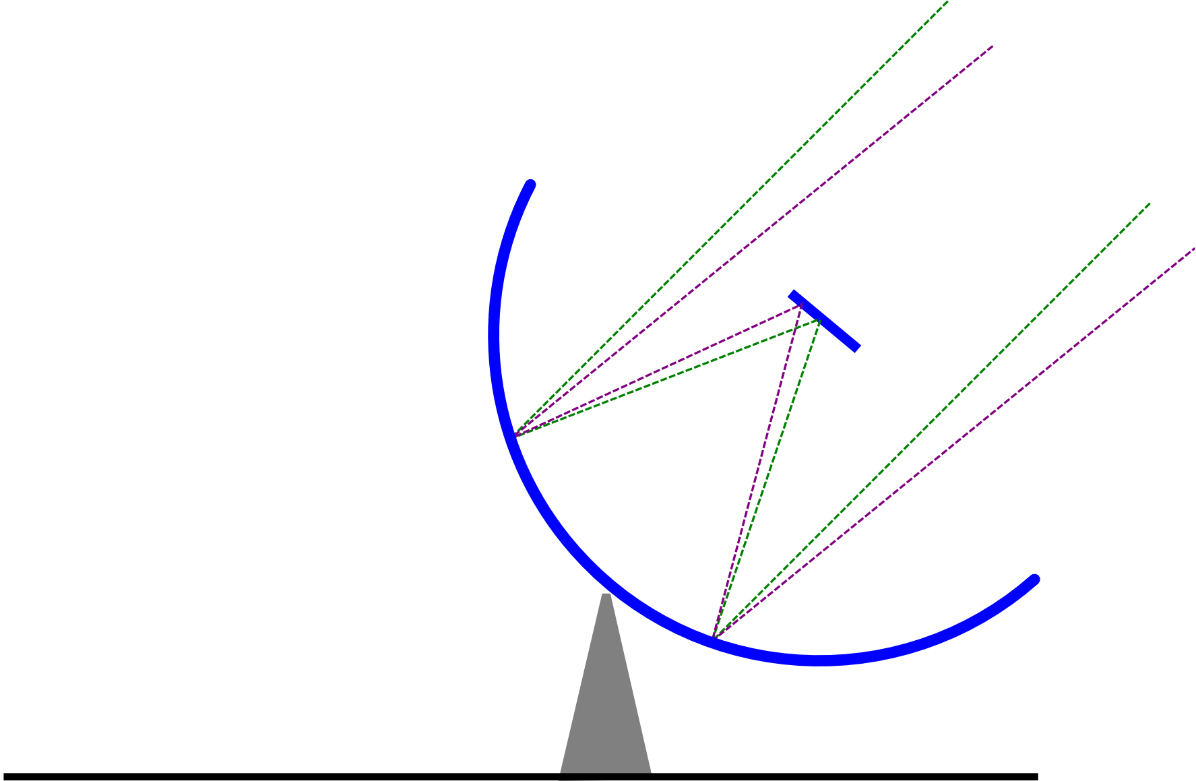
How To Make An Interferometer 1
Start with a normal reflector telescope....

Slide 8

How To Make An Interferometer 2
Then break it up into sections...

Slide 9
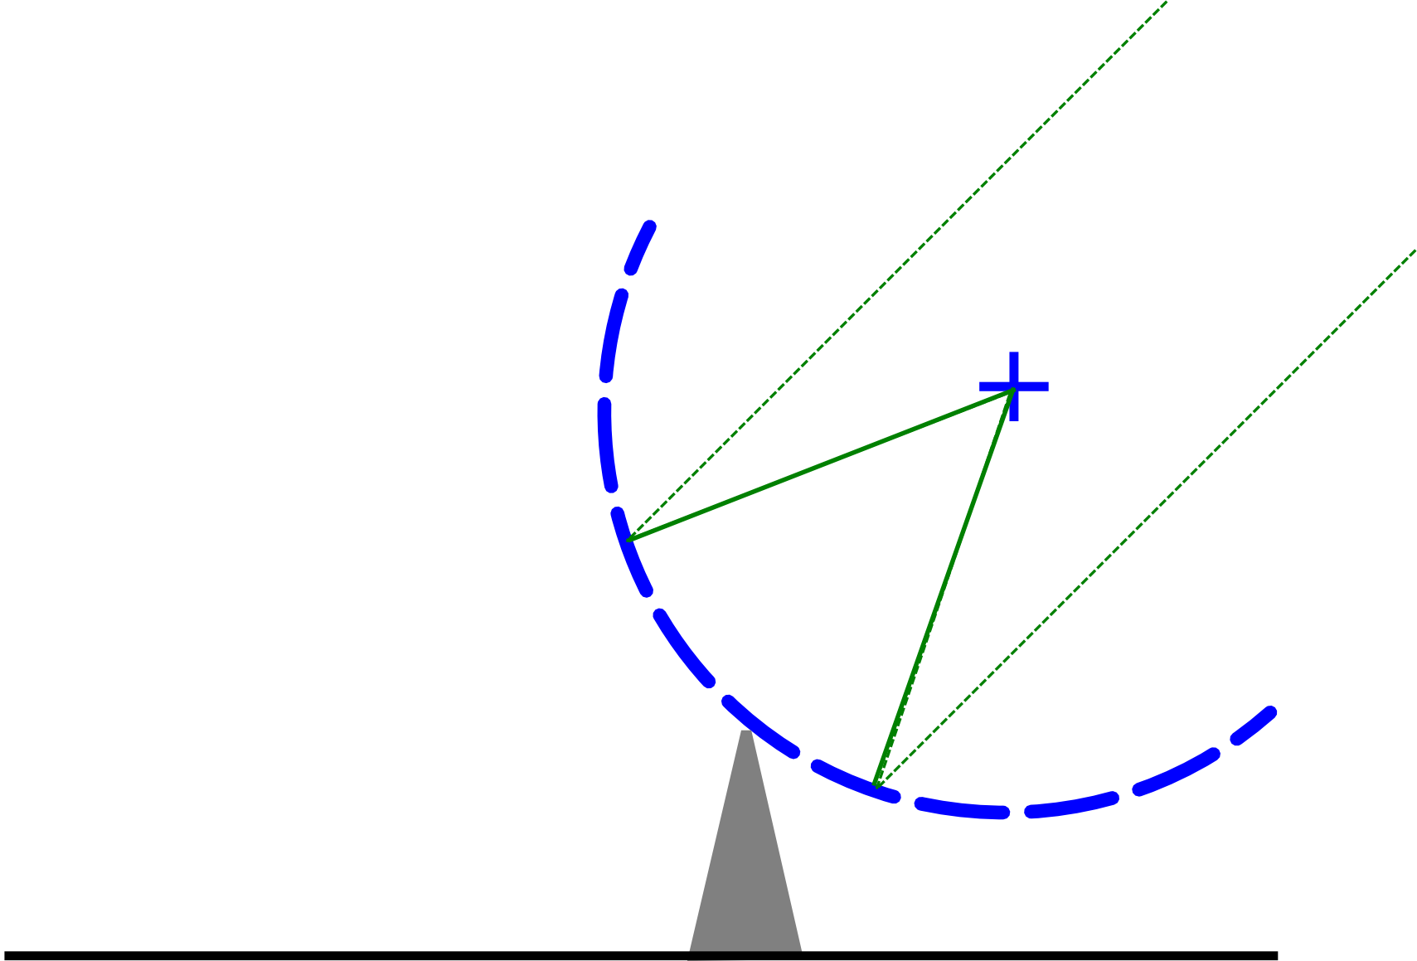
How To Make An Interferometer 3
Replace the optical path with electronics

Slide 10
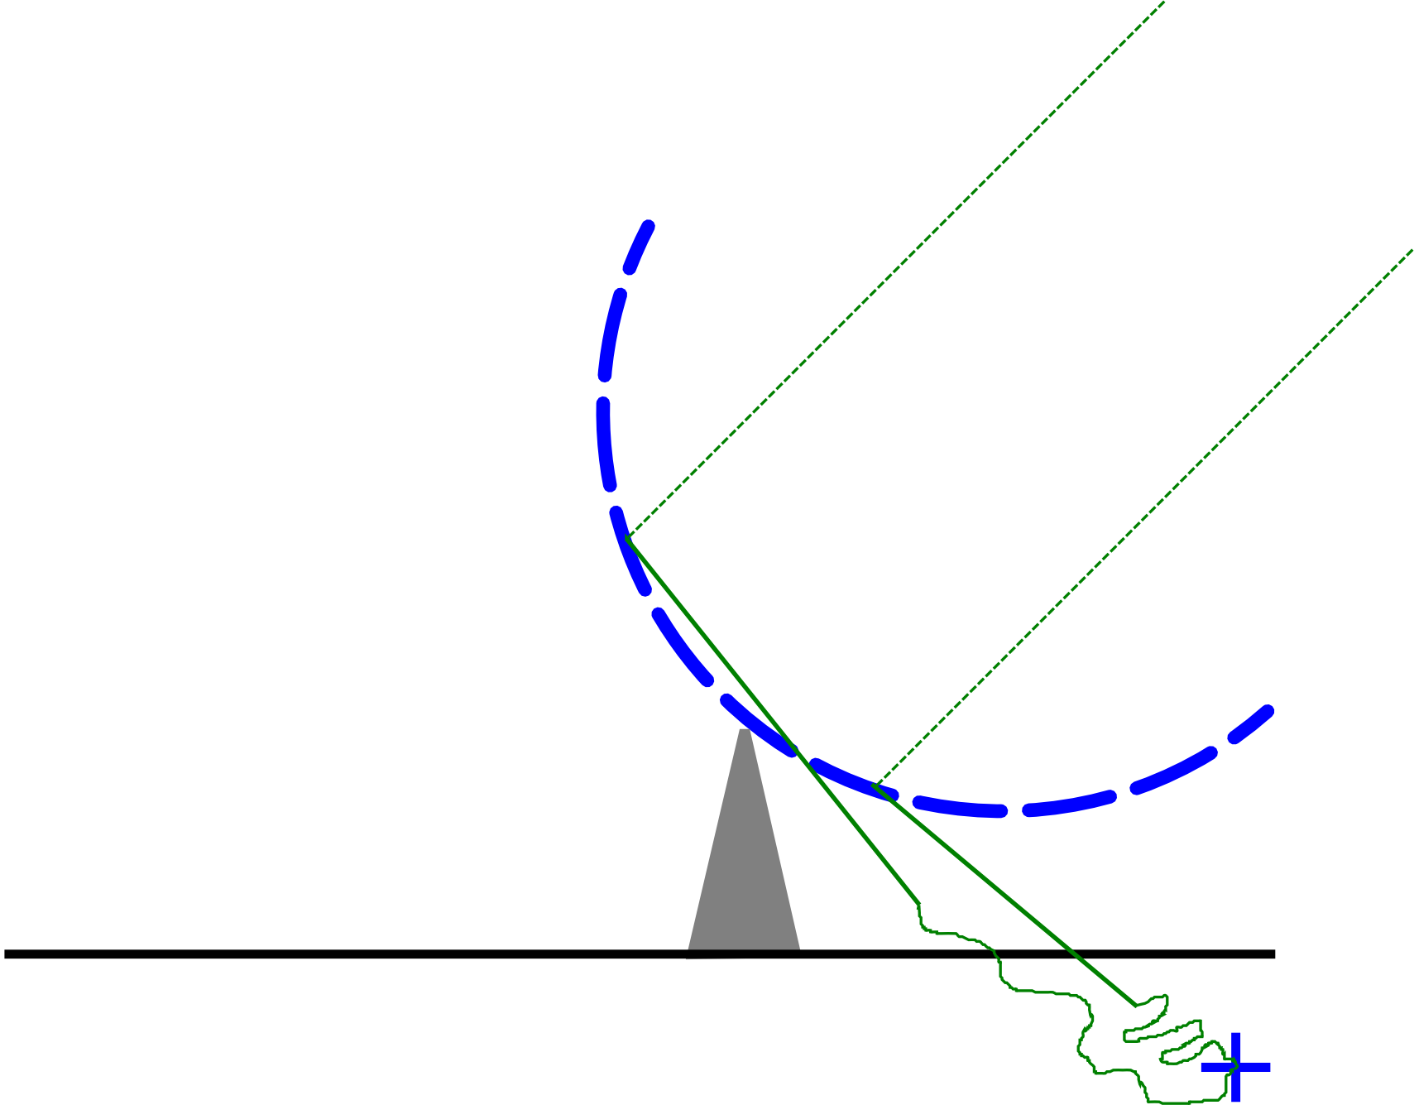
How To Make An Interferometer 4
Move the electronics outside the dish
...and add cable delays

Slide 11
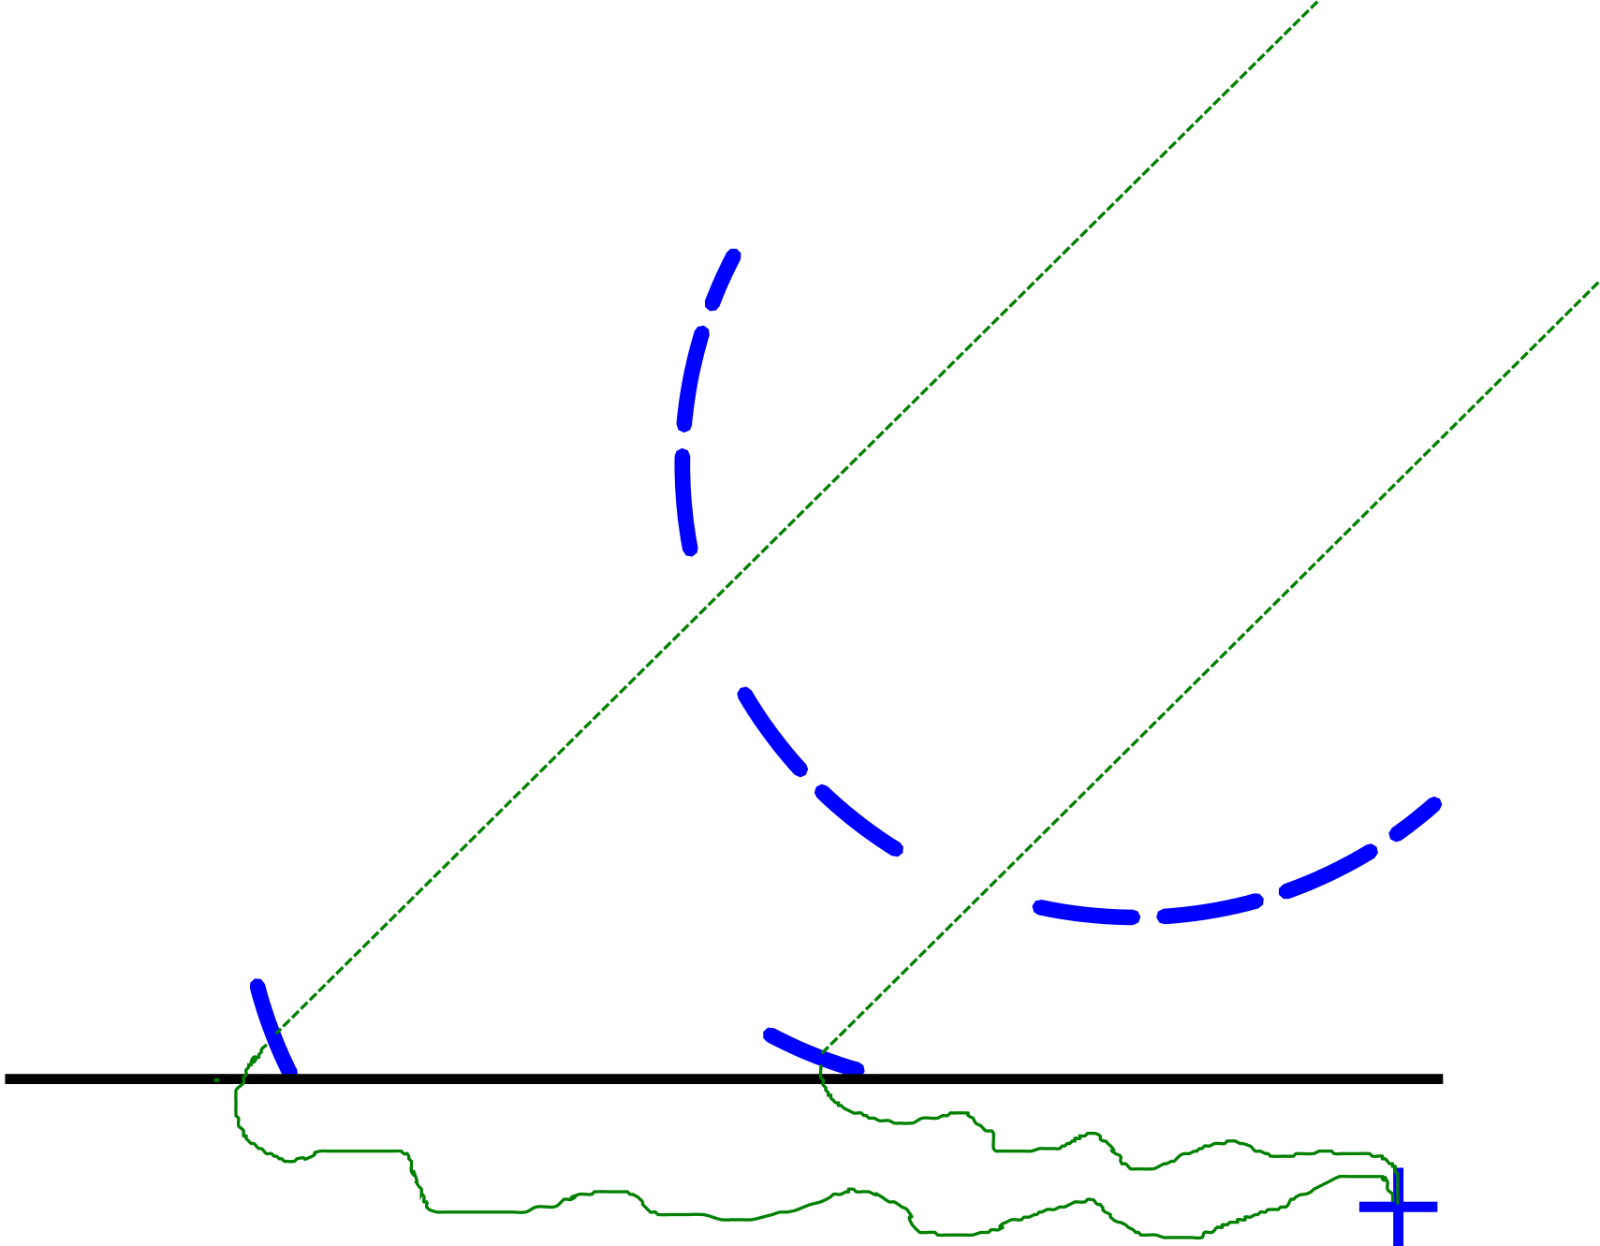
How To Make An Interferometer 5
Why not drop the
pieces onto the ground?

Slide 12
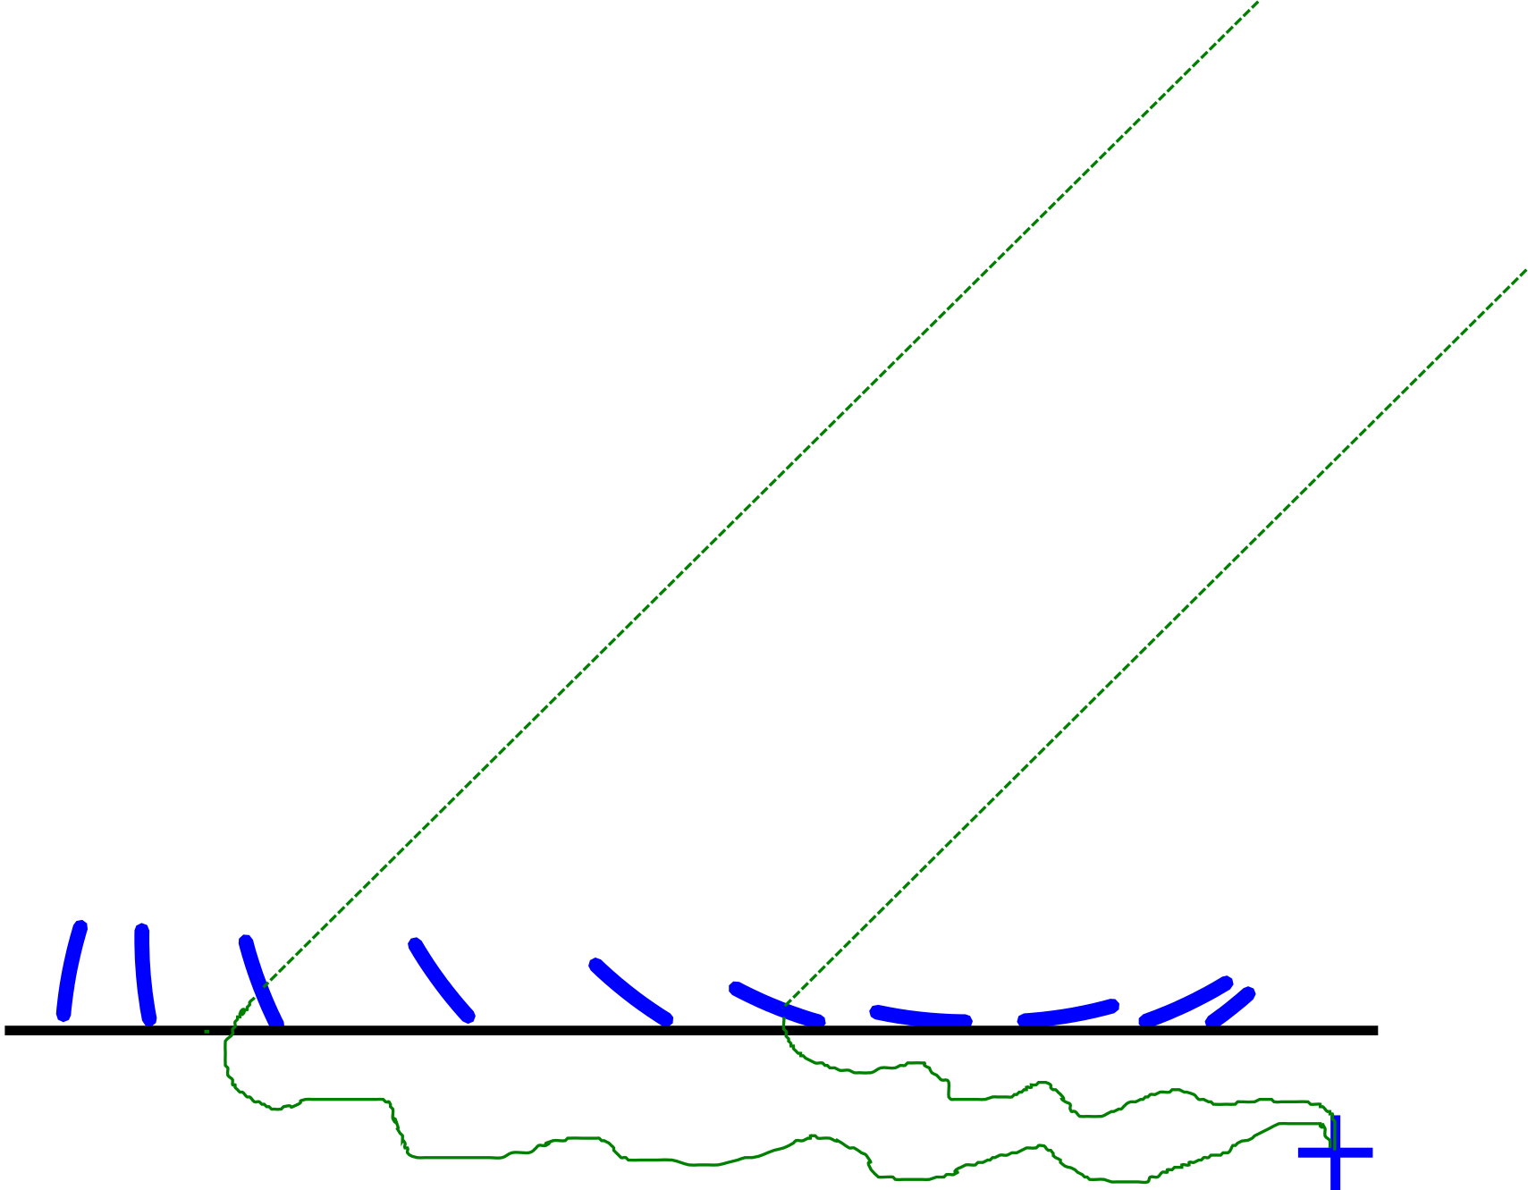
How To Make An Interferometer 6
...all of them

Slide 13
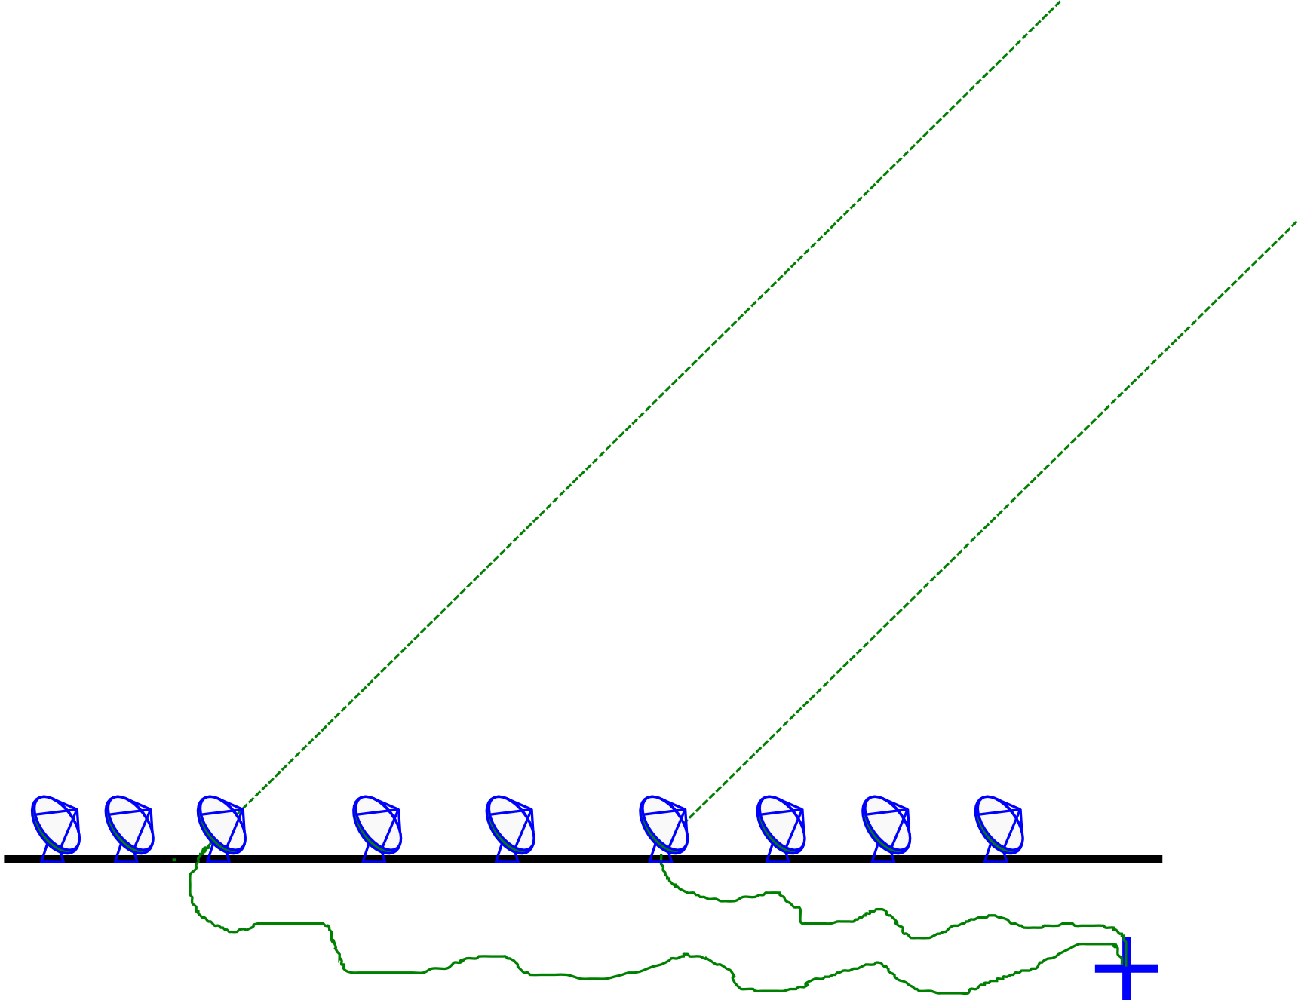
How To Make An Interferometer 7
And now replace them with proper radio dishes.
...and that's all! (?)
Well almost, what about the other pixels?

Slide 14
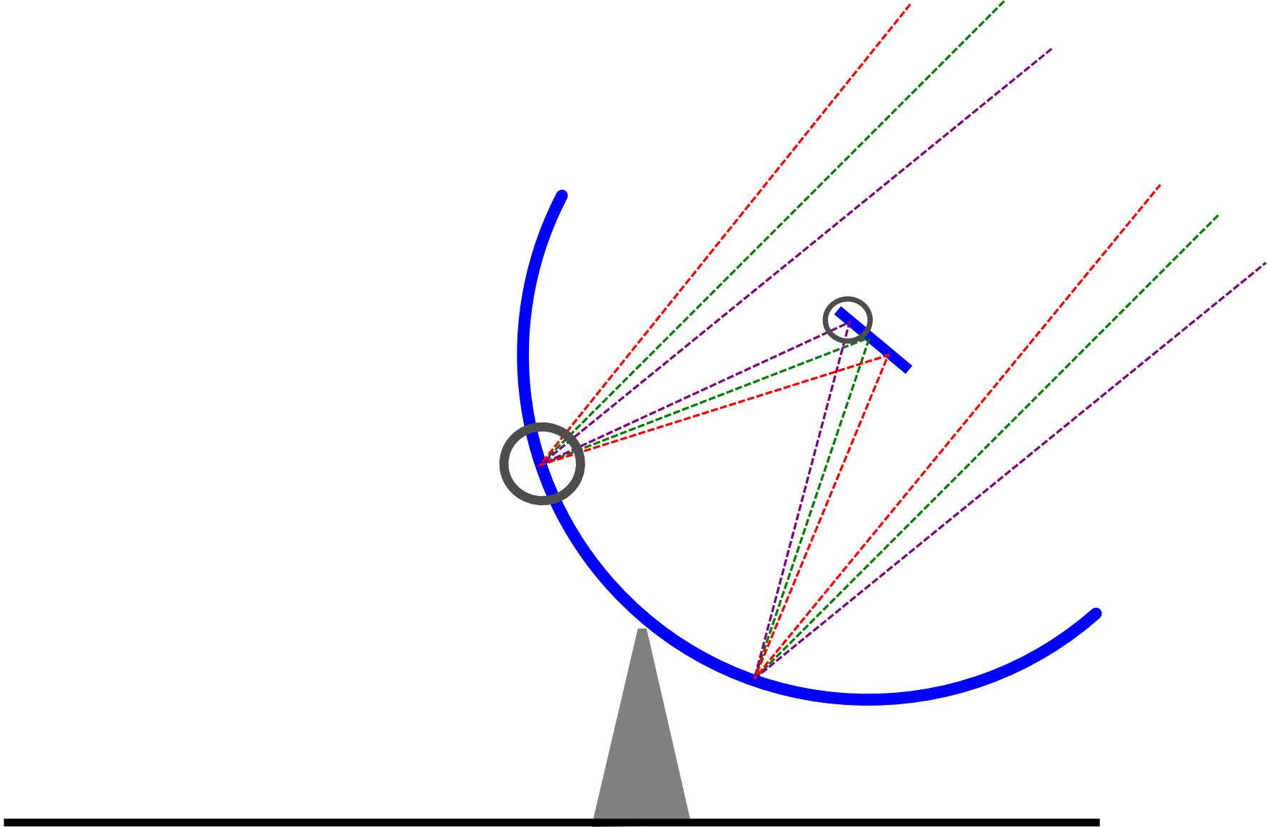
How Does Optical Imaging Do It?
This bit sees the EMF
from all directions,
added up together.
This bit sees the EMF
from all parts of the
dish surface,
added up together.

Slide 15
Fourier Transforms
An optical imaging system implicitly performs two Fourier transforms:
  1. Aperture EMF distribution = FT of the sky
  2. Focal plane = FT⁻¹ of the aperture EMF
A radio interferometer array measures (1)
  Then we do the second FT in software
  Hence, “aperture synthesis” imaging

Slide 16
A Few Problems
Gaps in the aperture... see later
Can't really measure & FT the EMF directly
  e.g. 1 GHz signal: that's a LOT of FTs per second
Instead, we can measure the coherency:
  i.e. sample fast, then
  integrate in the correlator,
  so the output sample
  rate is slow (~seconds)
...because that has all the interesting information

Slide 17
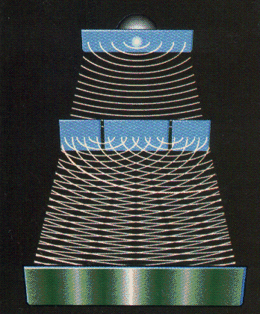
Why Coherency?
Recall the double slits: what does the photographic plate really measure?
  ...average intensity:
e(x) is a superposition of the signal from the two slits p and q:

Slide 18
The RIME
OK, let's step back and think about what we're really measuring
Hence, the radio interferometer measurement equation (RIME)
  Hamaker, Bregman, Sault 1996
  Hamaker 2000
Proper mathematical description of interferometry
  What we measure, how to calibrate, how to correct

Slide 19
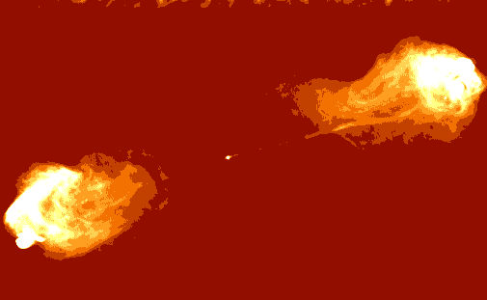
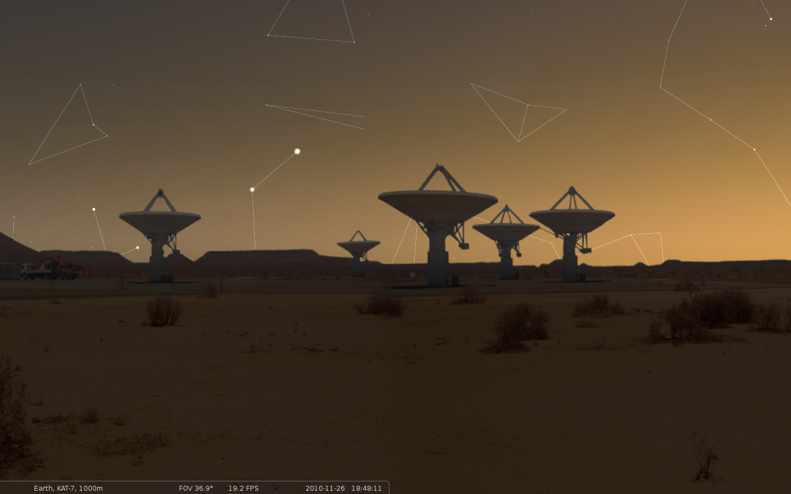
The Basics:
Vectors & Jones Matrices
A transverse EM field can be described by a complex vector:
x
A dual-receptor feed measures two complex voltages
(polarizations):
z
y
We assume all propagation effects
are linear. Any linear transform of a vector can be described by a matrix:

Slide 20
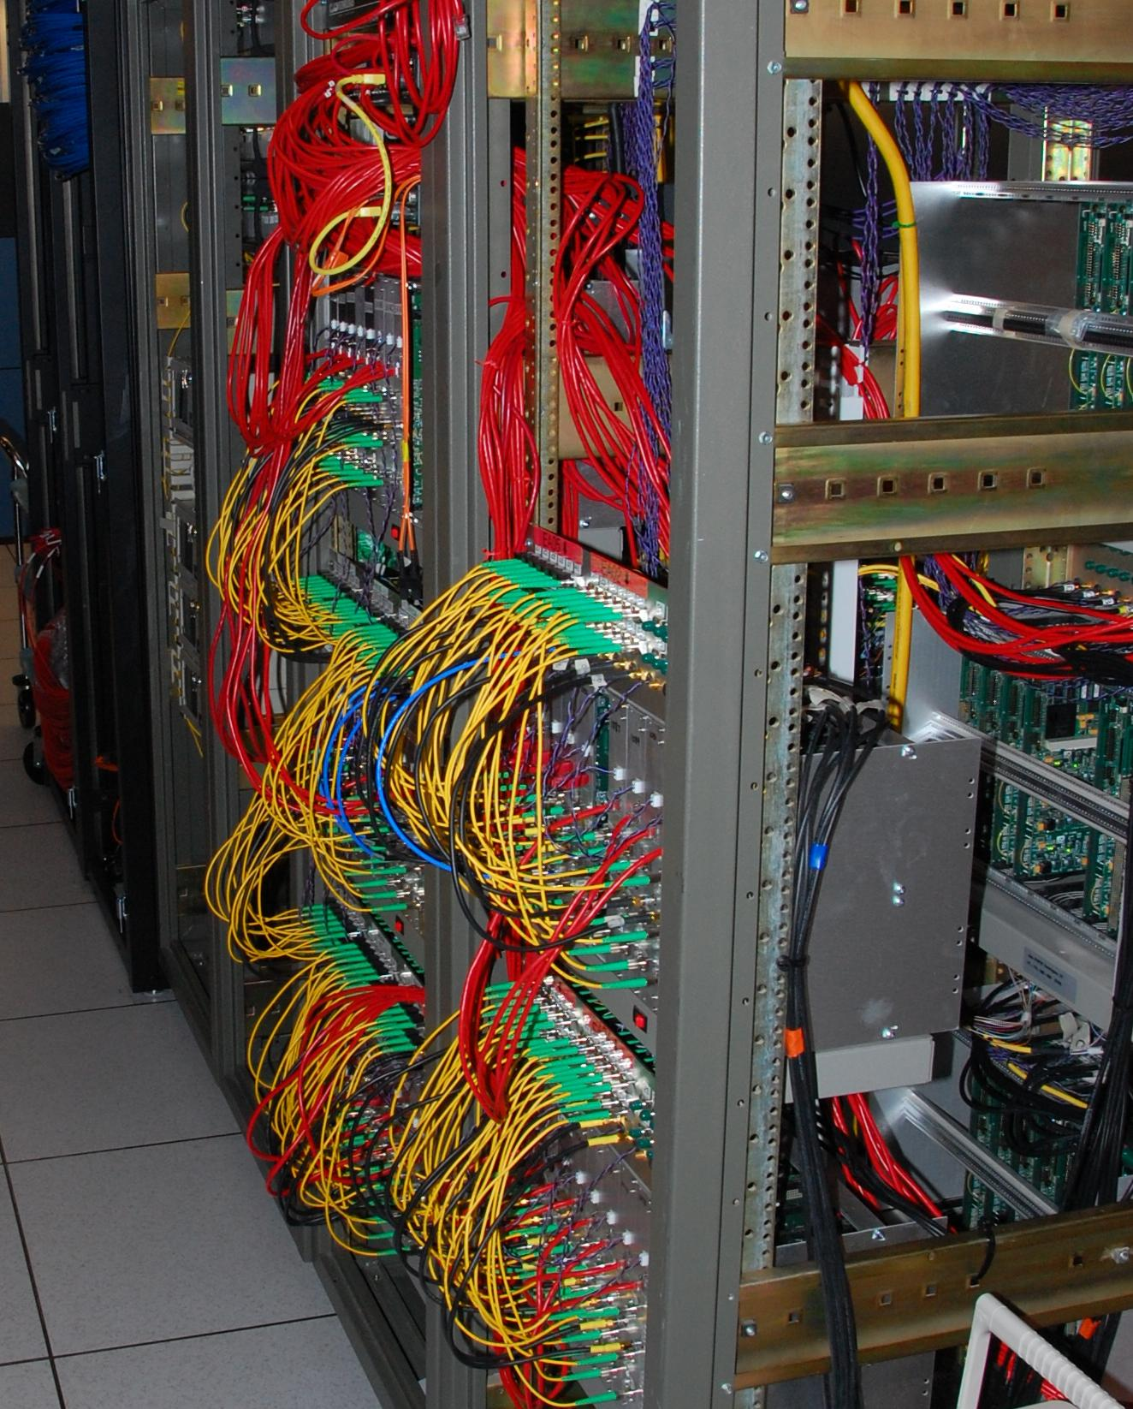
Correlation
The same signal reaches antennas p and q along two different paths. We then correlate the two sets of complex voltages.

Slide 21
The 2×2 Visibility Matrix

Slide 22
Coherencies & Stokes Parameters

Slide 23
And That's The RIME!
The RIME, in its simplest form:
measured
antenna p
source
antenna q

Slide 24
Jones Matrices:
The Crucial Ingredient
Each J is called a Jones matrix
With multiple effects in the signal path, overall J is a product of individual Jones terms:
Order of Js corresponds to the physical order of effects in your signal path.
Matrices (usually) don't commute!

Slide 25
Accumulating Jones Matrices

Slide 26
On Terminology...
The general formalism above is “The Radio Interferometry Measurement Equation”
  Or simply “The Measurement Equation”
When we want to describe a specific instrument and/or observation, we string together specific Jones terms, and derive a measurement equation
For example:

Slide 27
A Nursery RIME

Slide 28
Why Is This Great?
A complete and simple framework for describing all kinds of signal propagation effects.
...including those in the sky & at the antenna, e.g.:
  Ionosphere, troposphere
  beam & receiver gain
  parallactic angle rotation
  receptor cross-leakage
  “weird” antenna designs (aperture arrays, etc.)
Effortlessly incorporates polarization.

Slide 29
Why Is This Even Greater?
Most effects have a very simple Jones representation:

Slide 30
Three Layers Of Intuition
Physical: e.g. beam gain, parallactic angle
  beam pattern of X and Y dipoles different, causes polarization of off-center sources
  P.A. rotates polarization angle
Geometrical: stretching, rotation
  do not commute...
Mathematical: matrix properties

Slide 31
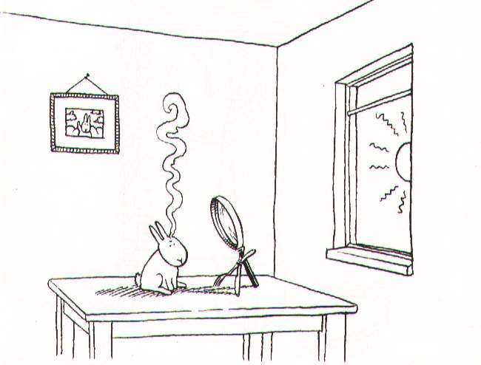
Part 2: A Lonely Lowly Point Source

Slide 32
The RIME Of A Single Point Source

Slide 33
Effects Of Integration
K is not constant because isn't.
  u,v,w coordinates scale with frequency
  baseline rotates with time (with the Earth)
So we have an average of a complex quantity with a rotating phase
Averaging reduces amplitude
  Time/requency smearing

Slide 34
Fringe Stopping
We can minimize the effects of smearing by inserting a delay in the correlator corresponding to zero phase in our direction of interest
Which is simply
This is called fringe stopping.
K then becomes:

Slide 35
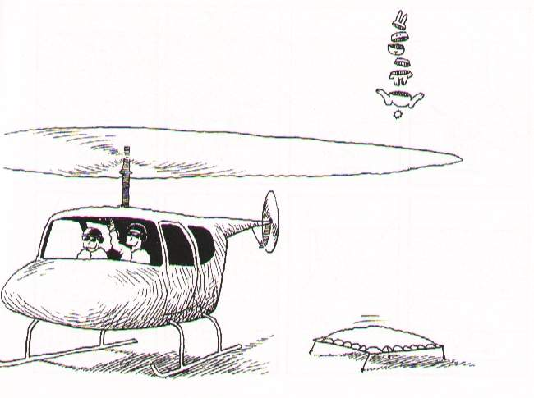
Part 3: Full Skies

Slide 36
A Sky Of Point Sources

Slide 37
A Sky Of Point Sources II
uv-plane effects apply to all directions (i.e. all sources) equally
  e.g. receiver gain
image-plane effects depend on direction
  e.g. beam pattern
source coherency is (in a sense) intrinsic, so we will often just use Xpq from here on.

Slide 38
The Full-Sky ME

Slide 39
The Full-Sky ME

Slide 40
Image-plane vs. uv-plane

Slide 41
And Back To The ME....

Slide 42
The Fourier Transform
The integral then becomes a 2D Fourier transform of the “apparent sky”.

Slide 43
The Fourier Transform 2
This is essentially the van Cittert-Zernike theorem
  ...as a simple consequence of the M.E. and our K Jones term.
Note that the original M.E. (Hamaker-Bregman-Sault, “ME Paper I”) was formulated purely in terms of cohaerency:
...so here we extend the M.E. into the image plane.

Slide 44
The Fly In The Ointment
In the general case, the exponent is not quite an F.T. kernel.
Let's collect the n-terms into an “N-Jones”, and define an “apparent projected sky”:

Slide 45
Apparent Skies & Apparent Cohaerencies
In other words, each antenna pair p-q measures an apparent cohaerency distribution Xpq(u,v) that corresponds to a 2D Fourier Transform of its own apparent projected sky Bpq.
...at a single point in time!

Slide 46
Time Is Not On Our Side
Cohaerencies are sampled along a “uv track” over some period of time:
The true sky B is probably constant(?) in time
Image-plane effects (beam shapes, ionosphere) will vary:
  ...both in time
  ...and across antennas
All this is especially relevant with low-frequency and/or wide-field observations.

Slide 47
The “Classic” Assumptions
Only under these assumptions can we consider a single F.T. of the sky to be an accurate representation of what an interferometer sees.

Slide 48
Conclusions
Under the “classic” assumptions, the visibilities measured by an array correspond to ONE cohaerency distribution X that is in an F.T. relationship with ONE apparent sky.
In the presence of non-trivial image plane effects, and/or with wide fields and noncoplanar arrays, each interferometer p-q measures its “own” cohaerency Xpq(t), corresponding to its “own” apparent sky Bpq(t) -- variable in time!
The K term becomes an F.T. kernel with narrow FOVs/coplanar arrays, but is “not quite” an F.T. otherwise.

Slide 49
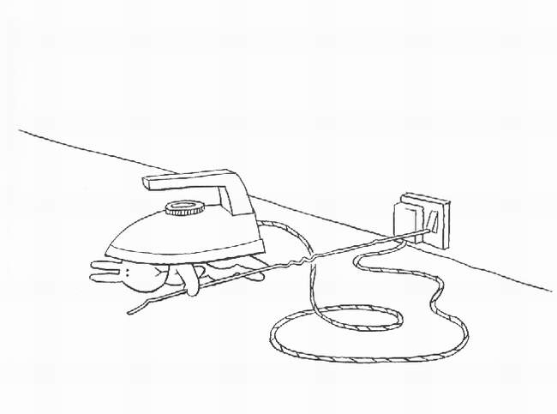
Part 4: Why RIME?

Slide 50
Why RIME?
What's so great about the RIME if used to do interferometry (mostly) fine without it?
For starters, polarization...
...but also, that it ties together physics, mathematics and geometry

Slide 51
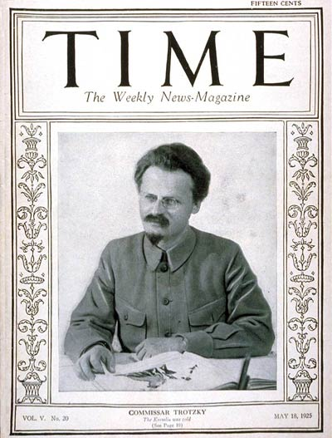
Polarization
“You may not be interested in the polarization, but the polarization is interested in you.”
– (wrongly) attributed to Leon Trotsky
Older telescopes were designed
to minimize instrumental polarization effects
So unless you were a masochpolarimetrist, you could dodge the issue entirely
Not so for the new regimes:
  Focal plane & aperture arrays, offset feeds: severe instrumental polarization
  Low frequencies: ionospheric FR

Slide 52
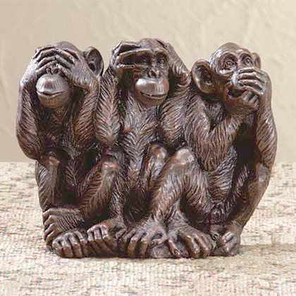
The Classical Approach To Polarization
V
Q
U

Slide 53
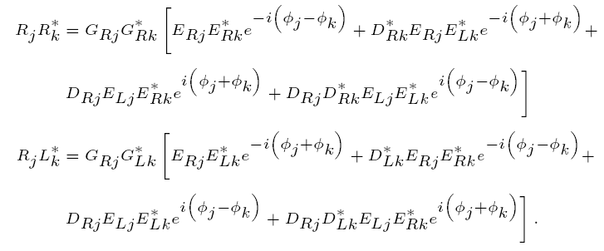
Scalar Equations For
Polarization Selfcal
RIME version:

Slide 54
Example:
Differential Faraday Rotation
Early testing of first LOFAR long baseline (Effelsberg-Exloo) showed puzzling signal:
  very strong XY/YX, very weak XX/YY, on unpolarized source
Caused much excitement in the corridors, but was eventually explained by differential Faraday rotation
Had actually been predicted (& forgotten) by Hamaker et al. in the original RIME paper
According to James Anderson, was known in the VLBI community during the 1960-70s, hence choice of circularly polarized feeds

Slide 55

DFR: The Physical View
Physical view: (lots of handwaving)

Slide 56
DFR: The RIME View
Assume a 1 Jy unpolarized source at the phase centre, and no other corruptions:

Slide 57
Math, Physics, Geometry
Ways to think about the RIME:
  Jones matrices are geometric transforms of 2-vectors
  i.e. coordinate transforms in 2D space
So you can think of your instrument as applying a series of 2D transforms to your original EMF vectors
...and bring linear algebra to bear
For example, here's how to understand a difficult problem...

Slide 58
Example: Correcting Data
If we have a RIME like this:
and we know the G's, can we “correct” the data to take them out?
Well yes, just invert the matrices:
...giving us the “uncorrupted” data (which we can image).
See any problems?

Slide 59
Uncorrectable Data
Not every matrix can be inverted, for example:
Physically, this corresponds to zero gain in the Y receptor (“loose cable”)
Irrecoverable loss of information, e.g.:
  ...source with I=1 Q=0.5 looks identical to one with I=1.5 Q=0
  So you've lost polarization and total flux

Slide 60
Perfectly Correctable Data
Other matrices are perfectly invertible:
Physically, this corresponds to rotated dipoles (so we just measure polarization in a different coordinate frame)
Is there a continuum of possibilities between the two cases?

Slide 61
Example: Dipole Projection
Aperture array with fixed NS and EW dipoles
Projection of dipoles onto tangential plane determines sensitivity to polarization
Equivalent to conventional dipole pair only at zenith
=90˚
=45˚ =45˚
=45˚ =15˚
N
=90˚
=15˚
W
E
S

Slide 62
Correcting For Projection
Is there a difference is correctability
between (a) and (b) ?
Yes, since we measure with noise, and with limited precision
  Computing an expression with large numbers and small numbers => loss of precision
So when we invert (a), we lose information
Is there a way to describe this more generally?

Slide 63
The Good, The Bad and The Ugly
Jones matrix = geometric transform
Example of a “good” matrix: rotation
“Bad” matrix: unequal gains (“squashing”)
“Ugly” matrix: non-invertible

Slide 64
And The General Case
Can we characterize an arbitrary matrix?
For any matrix, there exists a singular value decomposition (SVD):
...where U and V are unitary, and
g1 and g2 are called the eigenvalues

Slide 65
Unitary Matrices
Unitary matrices:
Unitary matrices preserve lengths
  e.g. rotations, phase shifts
Unitary Jones matrices are “good”, i.e. perfectly correctable

Slide 66
The IXR
We can therefore represent any Jones matrix as a sequence of two “good” unitary transforms and one “bad” diagonal one
The degree of information loss is completely given by the matrix condition number κ=g1/g2
  Low is good
Carozzi & Woan (2011) define the intrinsic cross-polarixation ratio (IXR):
  IXR→, relative error→0
  IXR→1, relative error→1

